Slide 1
How can Interreg make a difference TO7 network example
Annual event
Italia - Francia Maritimo 2014-2020
16 November 2017 I Genoa, Italy
Ulf Wikström, Interact

Slide 2
Brief overview
Thematic networks for Capitalisation led by Interact
Relation to Interreg Europe platforms
TO 7 Sustainable Transport network
Partners and state of play
Visions for the future

Slide 3
Thematic networks led by Interact
At present there are 6 networks available for Interreg programmes
To work together but different approach from Interreg Europe platforms
Knowledge of the seas
Sustainable transport TO 7
Migration
Climate change TO 5
Better governance TO 11
Inclusive growth TO 8,9,10

Slide 4
TO 7 Sustainable transport network
Started during second half of 2016
Personal contact to all programmes with the TO7
Identifying possible needs and wishes
19 programmes A (10), B (7) and C (2) strands, IPA, ENI
What we are aiming at doing
Learning
Sharing
Developing
Connecting

Slide 5
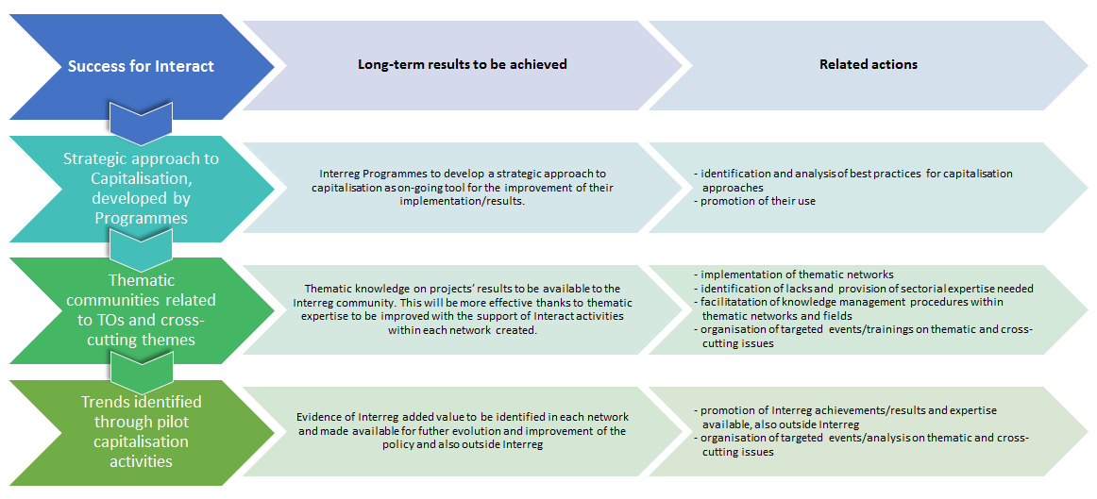
The Capitalisation concept
But I must explain to you how all this mistaken idea of denouncing pleasure and praising pain was born and I will give you a complete account of the system.
No one rejects, dislikes, or avoids pleasure itself, because it is pleasure, but because those who do not know how to pursue pleasure rationally encounter .
Format Headlines inside Text without bullets and Interact Colours
Nor again is there anyone who loves or pursues or desires to obtain pain of itself, because it is pain, but because occasionally circumstances occur in which toil and pain can procure him some great pleasure.

Slide 6
Capitalisation should not stop with communication. Good communication foster good capitalisation. Second wave of capitalisation happens when people understand the added value and they see the real results.

Slide 7
Interreg must belong to a context. We need to be linked to other activities, funds and developments. Show we want and can interact and make added value

Slide 8
Capitalisation aims at showing how Interreg makes a difference in society

Slide 9
How can TO 7 projects made a difference
Taking the initiative
Developing a process that expands the horizon of the “own” region. Example MarTech projects. Global activity ensure regional growth.
Taking the first step
Doing a feasibility study for the first ever railway between two countries. Example Greece- Albania Linking to national and EU funds and processes.

Slide 10
The added value can also be shown by
Being a test bed for developed projects
A Horizon project results and ideas need often to be tested and Interreg programs/regions would be extremely good for that
Complementing TEN-T activities
Building and connecting sub corridors to the major TEN-T corridors – or being partners in digitalisation projects in a blended concept with PPP

Slide 11
Interreg collect evidence and memory

Slide 12
Analysing good TO7 projects in KEEP
Programme | Project Name | Acronym | Period
Interreg North West Europe | Cycle Highways Innovation for smarter People Transport and Spatial Planning | CHIPS | 2014-2020
Interreg North West Europe | Hydrogen Solutions for Heavy duty transport Aimed at Reduction of Emissions in north west europe | H2Share | 2014-2020
Interreg Central Europe | Promotion of Multimodal Transport in Chemical Logistics | ChemMultimodal | 2014-2020
2007-2013 South Baltic Programme | Interface/Interface Plus | Interface/Interface Plus | 2007-2013
Interreg Finland-Estonia-Latvia-Sweden (Central Baltic) | Integrated System for Automated and Paperless Management of Transit Documents and for Tracking Movement of Goods in Real-Time | Mobi Carnet | 2014-2020
2007-2013 North West Europe | Towards Low CO2-Emission Urban Public Transport Infrastructures | Ticket to Kyoto | 2007-2013
Interreg Central Europe | Transnational Cooperation and Partnership for Better Public Transport in Peripheral and Cross-Border Regions | Peripheral Access | 2014-2020
2007-2013 Interreg South Baltic | Introducing electric mobility as intermodal transport mean in small & medium sized cities of the South Baltic area | ELMOS | 2007-2013
Interreg Central Europe | TEN-T Passenger Transport Connections to Border Regions | TRANS-BORDERS | 2014-2020
2007-2013 Alpine Space | Suistanable Mobility Information Network for the Alpine Space | AlpInfoNet | 2007-2013
2007-2013 Baltic Sea Region Programme | Baltic Biogas Bus: Increase the use of biogas buses in public transport to reduce the emissions in urban areas in the Baltic Sea Region | Baltic Biogas Bus | 2007-2013
2007-2013 North West Europe | Boosting Advanced Public Transport Systems | BAPTS | 2007-2013
Interreg North Sea Region | Caron Responsible Transport Strategies for the North Sea Region | Care North/Care North+ | 2007-2014
Interreg North Sea Region | Shared Mobility Solutions for a Liveable and Low Carbon North Sea Region | SHARE-North | 2014-2020
Interreg IVC | Flexible Transport Services and ICT Platform for Eco-Mobility in urban and rural european areas | FLIPPER | 2007-2013
2007-2013 Öresund-Kattegat-Skagerrak | Green STRING Transport Corridor | Green STRING Transport Corridor | 2007-2013
2007-2013 North West Europe | Last Mile Logistics | LaMiLo | 2007-2013
2007-2013 South East Europe | Network of Danube waterway Administration | NEWADA | 2007-2013
2007-2013 North West Europe | Regions of Connected Knowledge | RoCK | 2007-2013
2007-2013 South East Europe | Accessibility improved at border Crossing for the Integration of South East Europe | Acrossee | 2007-2013

Slide 13
Challenges for TO 7 Interreg investments huge task for the network…
1
3
Get to know
Share together
Develop
TO 7 is new for many
Trustworthy? Small vs big resources?
Joint portfolio & common work
Different challenges
Soft/hard investments
2

Slide 14
Challenges for TO 7 even more for +2020 Transport / Digitalisation / Environment
Work across funds
Work across TO:s
Establish a blended model
4
6
How can we show we are relevant and belonging to the good development
How can we be multi-
Modal in our thinking
How can we get the thematic expertise together
5

Slide 15
Cooperation works
Thank you for your attention!
www.interact-eu.net

