Slide 1
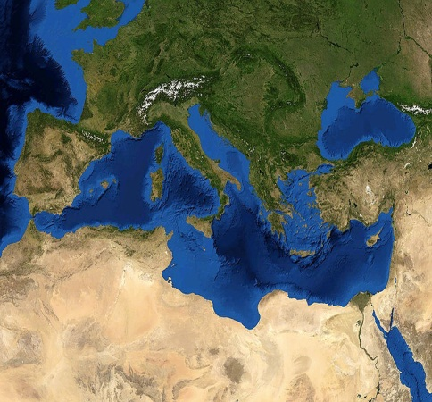
WestMED Communication an overview of the Initiative
European Commission - DG MARE
Maritime Policy and Blue Economy

Slide 2
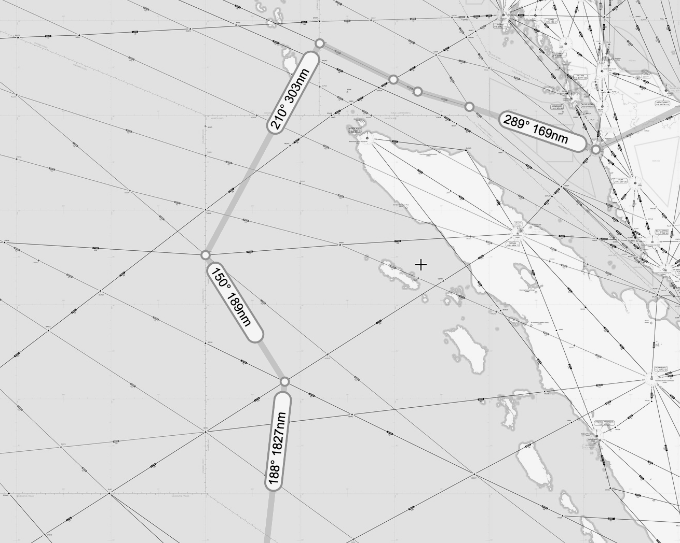
WestMED Initiative: the waypoints
UfM Ministerial Declaration on Blue Economy signed on 17 November 2015 invited to
" explore the feasibility and added value" of an Initiative in the Western Mediterranean
Communication 183 (2017) and Staff Working Documents (Framework for Actions) have been adopted by the Commission on 19 April;

Slide 3
WestMED Initiative: the waypoints
Achieved results have been welcomed by EU Ministers responsible for the Integrated Maritime Policy on Blue Growth in the Valletta Declaration of 20 April 2017
The Council in its Conclusions on Blue Growth on 26 June 2017 endorsed the WestMED Initiative and invited the countries involved, the European Commission and the UfM Secretariat to take forward its implementation.
On 3 July political support has already been assured at UfM SOM level.

Slide 4
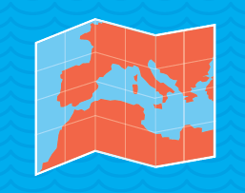
WestMED Initiative
3 Goals
10 Countries
Algeria, France, Italy,
Libya, Malta, Mauritania,
Morocco, Portugal,
Spain and Tunisia

Slide 5
WestMED Initiative
Cooperation between Coast Guards
Maritime Safety and response to Marine Pollution
Maritime monitoring data sharing
Reinforcement of border surveillance
Strategic research and innovation
Maritime cluster development
Skills development and circulation
Sustainable consumption and production
Maritime Spatial planning and coastal management
Marine and maritime knowledge
Biodiversity and habitat conservation
Sustainable fisheries

Slide 6
WestMED Initiative - Funding sources
No Additional Funds, those already available are estimated at 4 billion Euro or more
The European Maritime and Fisheries Fund (EMFF), the EU programme for the Competitiveness of Enterprises and SMEs (COSME), the European Neighboroug Instrument (ENI), the European Regional Development Fund (ERDF), National funds, the European Fund for Strategic Investments (EFSI) and the European Fund for Sustainable Development (EFSD)

Slide 7
WestMED Initiative
The next steps
End November 2017: Political endorsement by the 10 Countries
And Governance Structure – Informal Ministerial Meeting
Assistance Mechanism (operational from early 2018) will support governance and implementation of the Initiative and its Framework for Action

Slide 8
Thank you!

