Slide 1
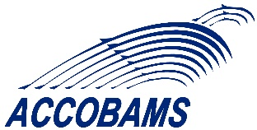
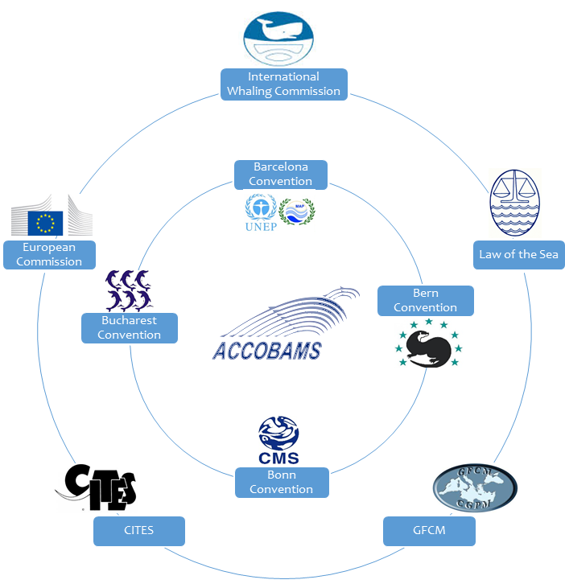
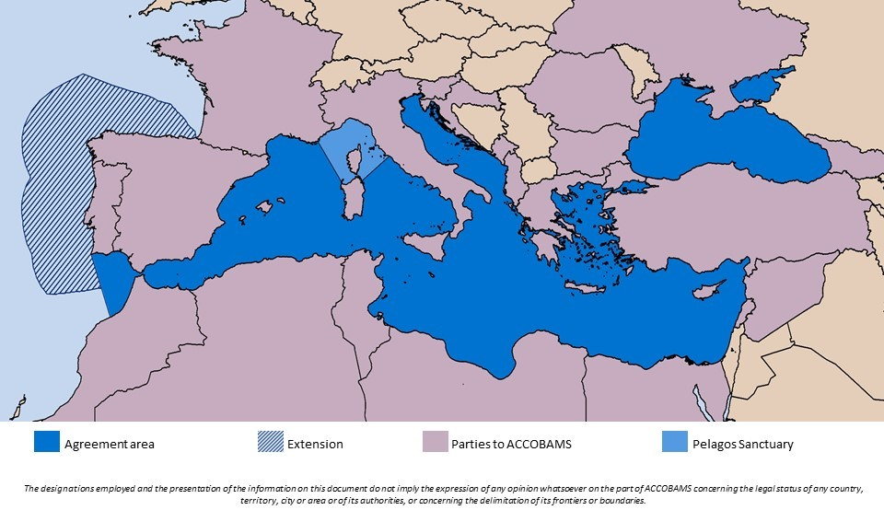
ACCOBAMS : an international Agreement
Agreement on the Conservation of Cetaceans of the Black Sea, Mediterranean Sea and contiguous Atlantic area
November 2018 = 24 Parties
Notes:
ACCOBAMS est le fruit de consultations menées entre les Secrétariats de quatre Conventions traitant de la conservation des cétacés
- la Convention de Barcelone pour la protection du milieu marin et du littoral de la Méditerranée et son Protocole relatif aux aires spécialement protégées et à la diversité biologique en Méditerranée,
- la Convention de Bonn sur la conservation des espèces migratrices appartenant à la faune sauvage,
- la Convention de Berne relative à la conservation de la vie sauvage et du milieu naturel de l’Europe,
- la Convention de Bucarest sur la protection de la Mer Noire contre la pollution.
Ainsi, tenant compte du caractère migratoire de ces espèces, l'Accord a été conclu sous les auspices de la Convention de Bonn (PNUE/CMS). Cette Convention cadre des Nations Unies encourage l'élaboration d'outils indépendants et juridiquement contraignants pour les Etats concernés et adaptés aux besoins de régions particulières.
Cet Accord, signé à Monaco le 24 novembre 1996, est entré en vigueur le 1er juin 2001.
Le Secrétariat Permanent est hébergé par la Principauté avec un Accord de siège

Slide 2
ACCOBAMS: CONCILIATE HUMAN ACTIVITIES AND CETACEAN CONSERVATION
Implement a detailed Conservation Plan to achieve and maintain a favorable conservation status for cetaceans.
Human Activities
Knowledge of human activities within the ACCOBAMS area
+
+
Important areas for cetaceans
Knowledge of the distribution of the different species
= Threats for cetaceans
= Better management of threats for cetaceans
Implementation of an integrated management: find solutions to conciliate human activities and cetacean conservation
Notes:
ACCOBAMS est un outil coopératif pour la conservation de la biodiversité qui concrétise la volonté des pays de préserver les cétacés en imposant des mesures plus restrictives que celles définies dans les textes adoptés sous d’autres Conventions.

Slide 3
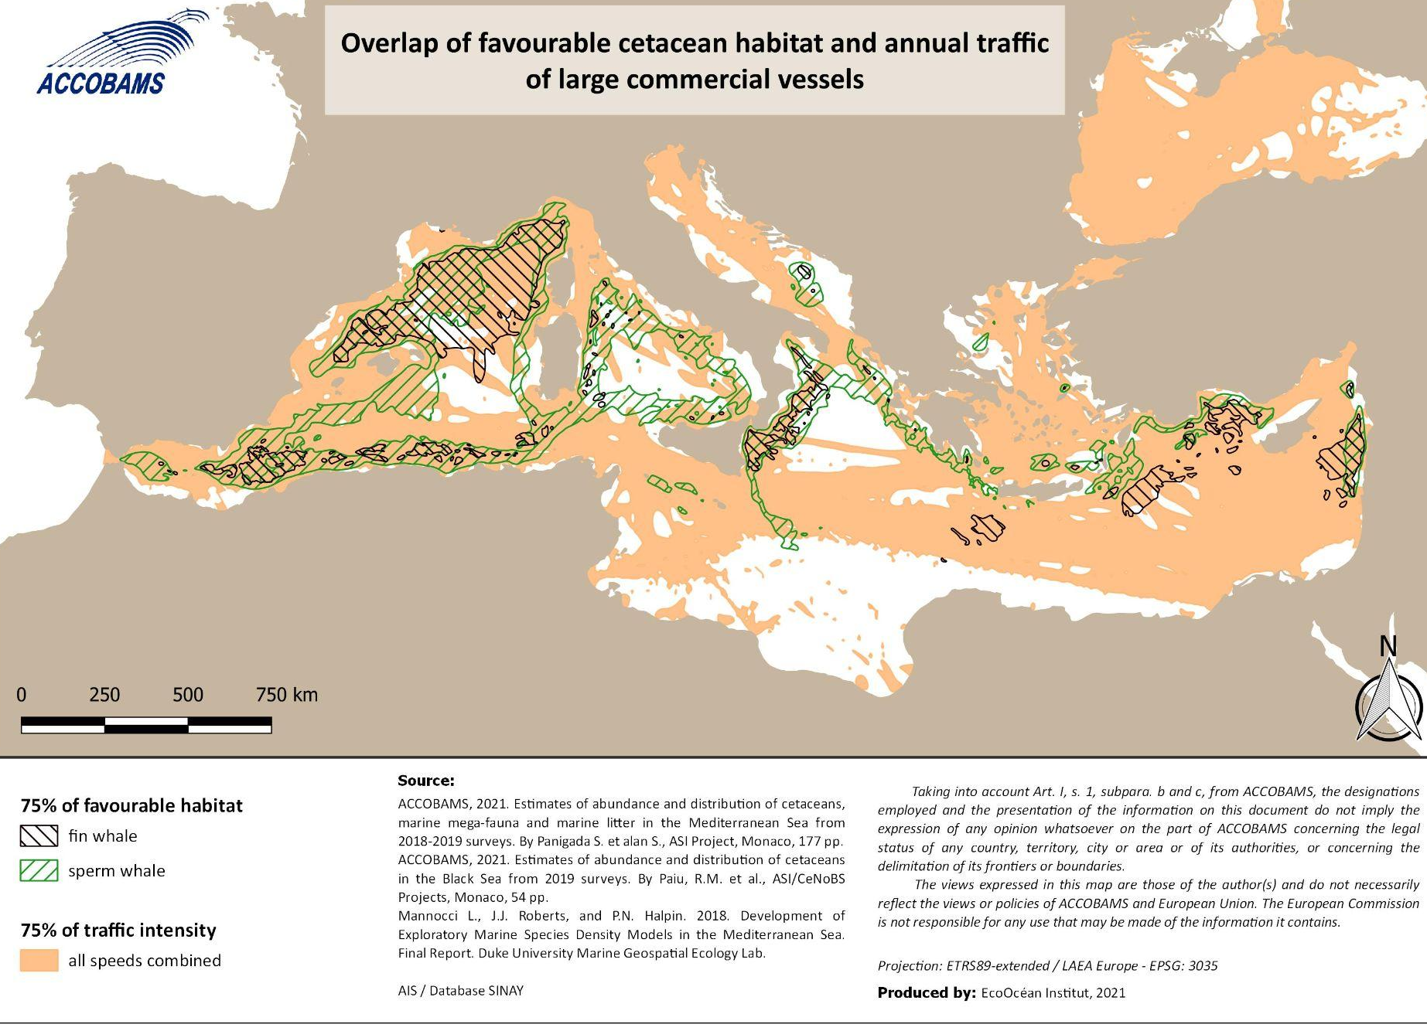
ACCOBAMS: CONCILIATE HUMAN ACTIVITIES AND CETACEAN CONSERVATION
Over the last 3 years, ACCOBAMS continued work on ship strikes, especially through:
1- revising CCH by taking into account both the known distribution of cetaceans and the threat-based management approach. By overlapping both it is possible to identify areas in need of conservation measures;

Slide 4
ACCOBAMS: CONCILIATE HUMAN ACTIVITIES AND CETACEAN CONSERVATION
Over the last 3 years, ACCOBAMS continued work on ship strikes, especially through:
1- revising CCH by taking into account both the known distribution of cetaceans and the threat-based management approach. By overlapping both it is possible to identify areas in need of conservation measures;

Slide 5
ACCOBAMS: CONCILIATE HUMAN ACTIVITIES AND CETACEAN CONSERVATION
Over the last 3 years, ACCOBAMS continued work on ship strikes, especially through:
1- revising CCH by taking into account both the known distribution of cetaceans and the threat-based management approach. By overlapping both it is possible to identify areas in need of conservation measures;
2 - the Scientific Committee is working on CMP for Mediterranean fin whales, to which ship strikes pose a serious threat;
3- collaborations (projects, other organizations…) - joint workshop IWC/IUCN/ACCOBAMS on ship strikes and IMMAs recommended ACCOBAMS to support the designation process of a PSSA including the North West Mediterranean Sea, Slope and Canyon IMMA, plus potentially the Spanish corridor, to take into account the whale population distribution and migration pattern. Mitigation tools such as speed reduction and de-routing could be considered as protective measures in the PSSA.

Slide 6
ACCOBAMS: CONCILIATE HUMAN ACTIVITIES AND CETACEAN CONSERVATION
Recommendation 14.7 on ship strikes (extracts)
The SC recognizes the following High-Risk Areas, where ship strikes are common in the ACCOBAMS Region, and recommends that mitigation measures are implemented as a matter of urgency:
1. Strait of Gibraltar - fin and sperm whales
2. Balearic Islands - fin and sperm whales
3. Balearic Basin and Catalan Coast – fin and sperm whales
4. Eastern Alborán Sea - fin and sperm whales
Pelagos Sanctuary - fin and sperm whales
Hellenic Trench, Greece - sperm whales
Measures that separate whales from vessels (or at least minimise co-occurrence) in space and time to the extent possible are the most effective, where this is possible (e.g., routing schemes). Where routing to keep whales and vessels apart is not possible, the only demonstrated measure to reduce fatal collisions with most large whales is to reduce speed

